Slide 1


DECODE GAMING BEHAVIOUR
BY: EDEM MOSES AGGOR

Slide 2
TABLE OF CONTENT
INTRODUCTION
DATASET DESCRIPTION
CLEANING
UNDERSTANDING THE GAME
ANALYSIS

Slide 3
INTRODUCTION
"Decode Gaming Behavior" entails examining the "Player Details" and "Level Details" tables in a gaming application's dataset.
Its goal is to obtain performance and behavior insights from players. We seek to comprehend user involvement, skill growth, and areas for improving the gaming experience through the use of SQL queries.
Analysis of performance data, player trends, and level completion rates are important questions. Our objective is to offer practical information so that game developers may make wise decisions.
The project includes approaches for data visualization, query formulation, result interpretation, and data exploration. We support stakeholders' comprehension and decision-making in game creation and management through succinct presentation.

Slide 4
DATASET DESCRIPTION
Player Details Table:
• `P_ID`: Player ID
• `PName`: Player Name
• `L1_status`: Level 1 Status
• `L2_status`: Level 2 Status
• `L1_code`: Systemgenerated Level 1 Code
• `L2_code`: Systemgenerated Level 2 Code
Level Details Table:
• `P_ID`: Player ID
• `Dev_ID`: Device ID
• `start_time`: Sart Time
• `stages_crossed`: Stages Crossed
• `level`: Game Level
• `difficulty`: Difficulty Level
• `kill_count`: Kill Count
• `headshots_count`: Headshots Count
• `score`: Player Score
• `lives_earned`: Extra Lives Earned

Slide 5
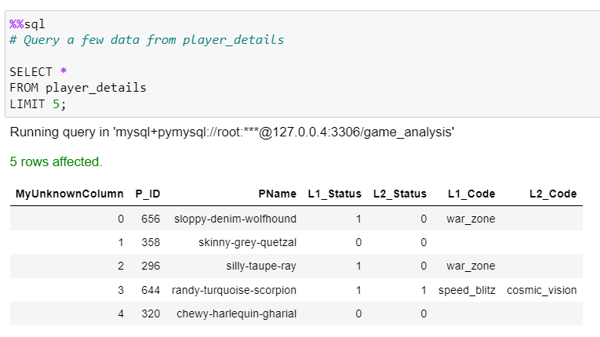
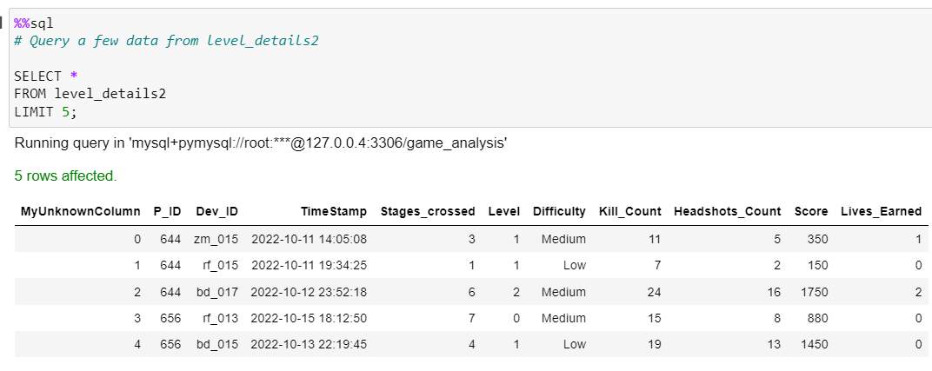
Before cleaning
AFTER IMPORTING OUR TABLES, WE QUERY A FEW DATA FROM THE TABLES TO HAVE A FAIR IDEA OF WHAT WE ARE WORKING WITH

Slide 6
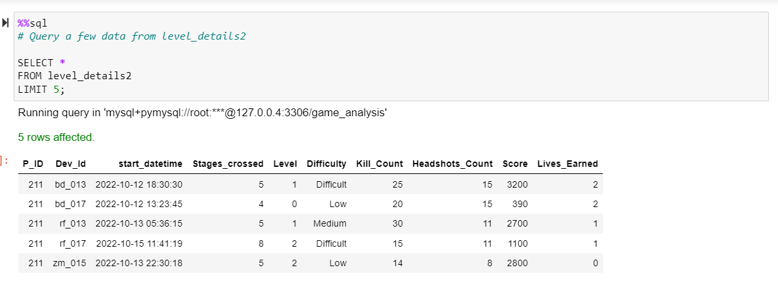
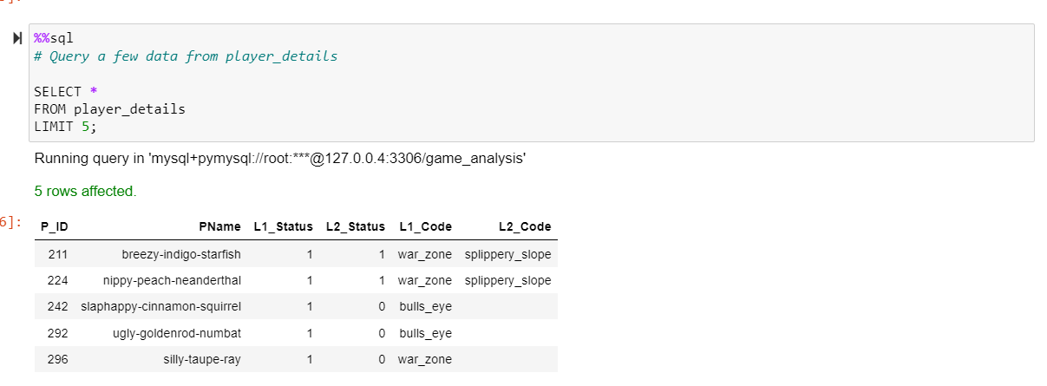
CLEANING
After cleaning, these are our tables for player details and level details

Slide 7
UNDERSTANDING THE GAME
Players play a game divided into 3-levels (L0,L1 and L2)
Each level has 3 difficulty levels (Low,Medium,High)
At each level,players have to kill the opponents using guns/physical fight
Each level has multiple stages at each difficulty level.
A player can only play L1 using its system generated L1_code.
Only players who have played Level1 can possibly play Level2 -- using its system generated L2_code.
By default a player can play L0.
Each player can login to the game using a Dev_ID.
Players can earn extra lives at each stage in a level.

Slide 8
ANALYSIS
USING JUPYTER NOTEBOOKS WE ARE GOING TO BE MAKING SOME ANALYSIS BASED ON OUR USER DATA TO GENERATE INSIGHTS INTO USER DATA AND GAMING BEHAIOURS.

Slide 9
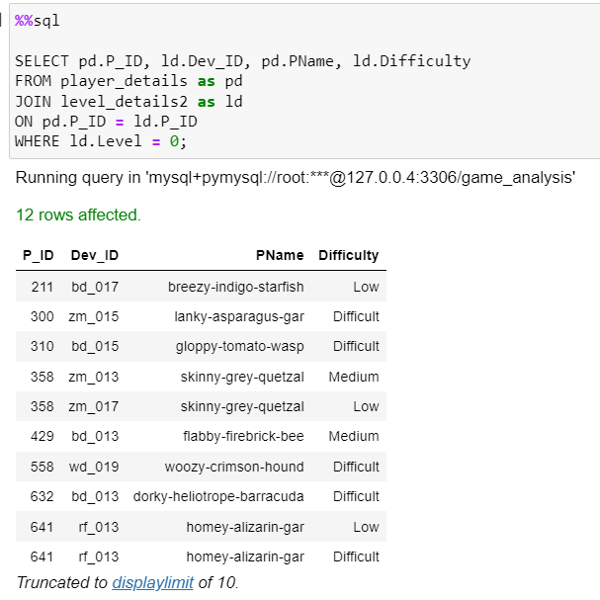
QUESTION 1
Extract `P_ID`, `Dev_ID`, `PName`, and `Difficulty_level` of all players at Level 0.

Slide 10
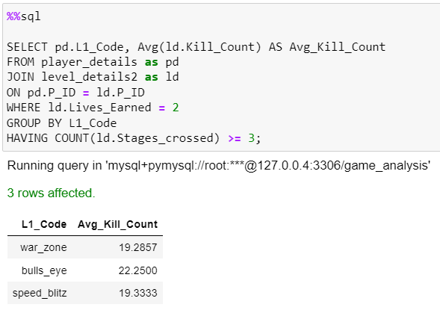
QUESTION 2
Find `Level1_code`wise average `Kill_Count` where `lives_earned` is 2, and at least 3 stages are crossed

Slide 11
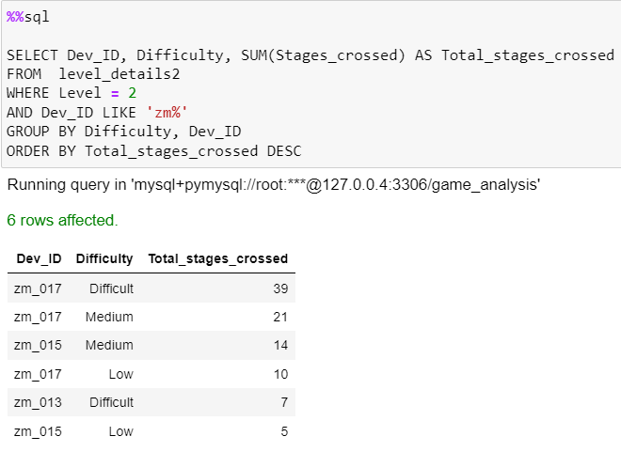
QUESTION 3
Find the total number of stages crossed at each difficulty level for Level 2 with players using `zm_series` devices. Arrange the result in decreasing order of the total number of stages crossed.

Slide 12
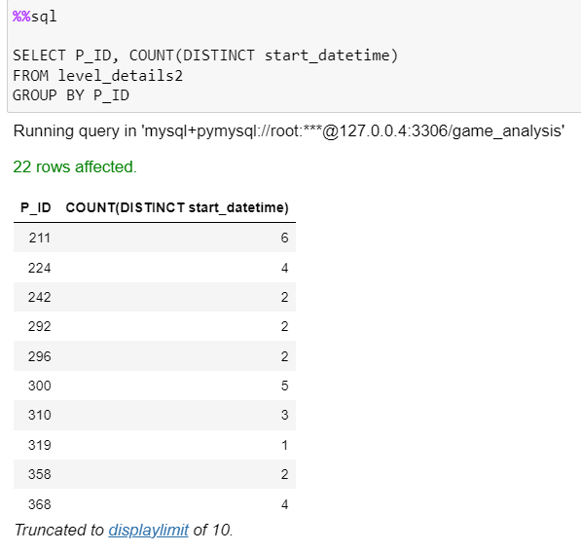
QUESTION 4
Extract `P_ID` and the total number of unique dates for those players who have played games on multiple days.

Slide 13
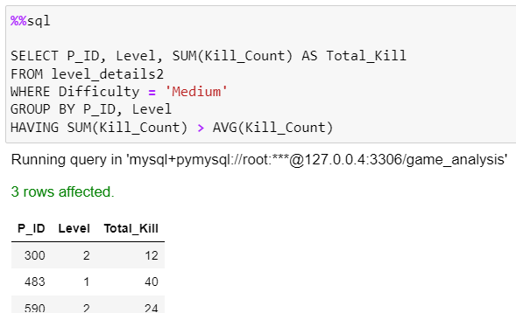
QUESTION 5
Find `P_ID` and levelwise sum of `kill_counts` where `kill_count` is greater than the average kill count for Medium difficulty.

Slide 14
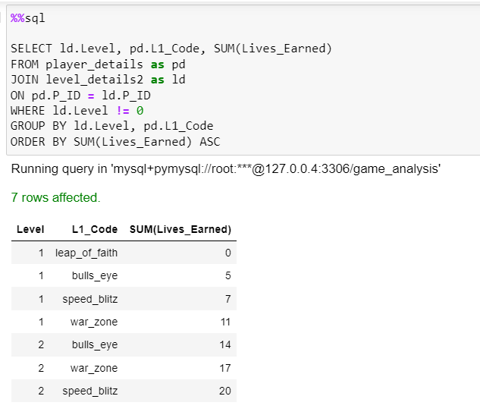
QUESTION 6
Find `Level` and its corresponding `Level_code`wise sum of lives earned, excluding Level 0. Arrange in ascending order of level.

Slide 15
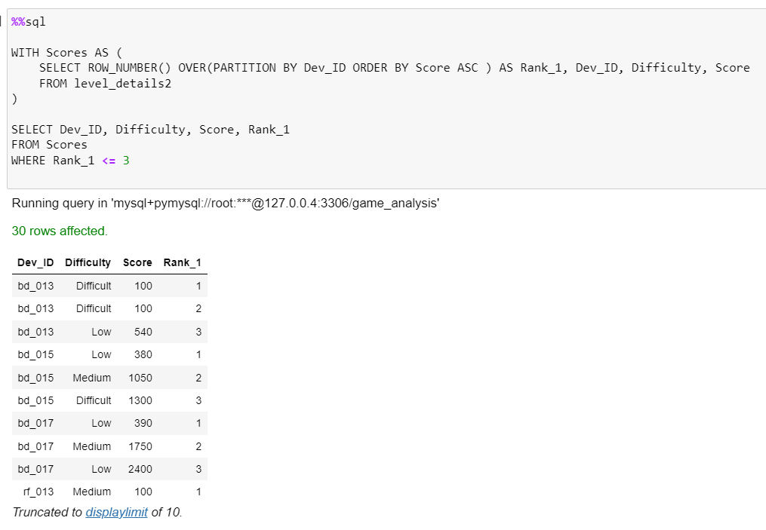
QUESTION 7
Find the top 3 scores based on each `Dev_ID` and rank them in increasing order using `Row_Number`. Display the difficulty as well.

Slide 16
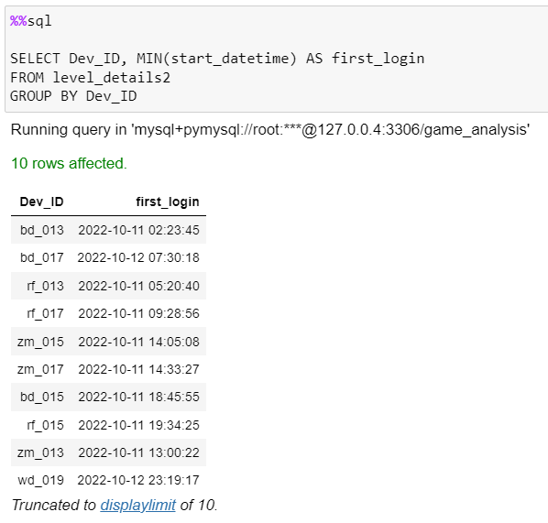
QUESTION 8
Find the `first_login` datetime for each device ID.

Slide 17
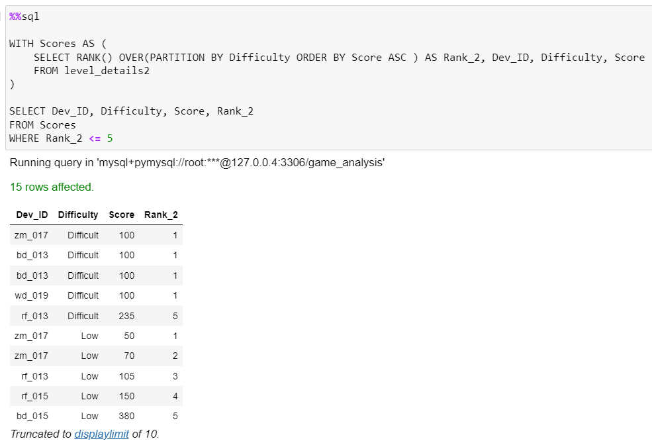
QUESTION 9
Find the top 5 scores based on each difficulty level and rank them in increasing order using `Rank`. Display `Dev_ID` as well

Slide 18
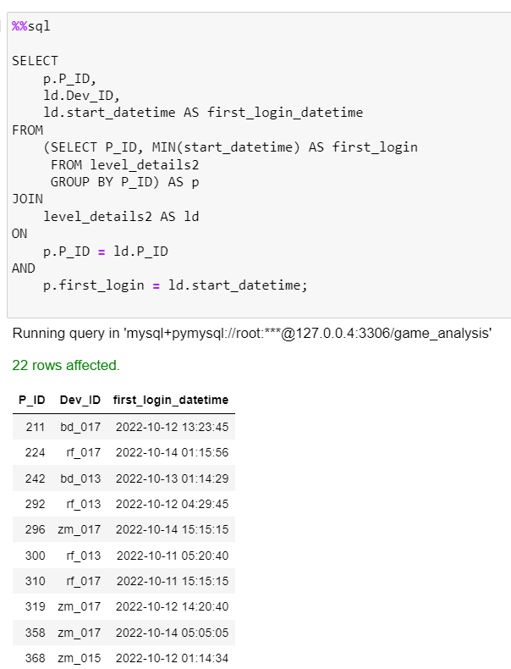
QUESTION 10
Find the device ID that is first logged in (based on `start_datetime`) for each player (`P_ID`). Output should contain player ID, device ID, and first login datetime.

Slide 19
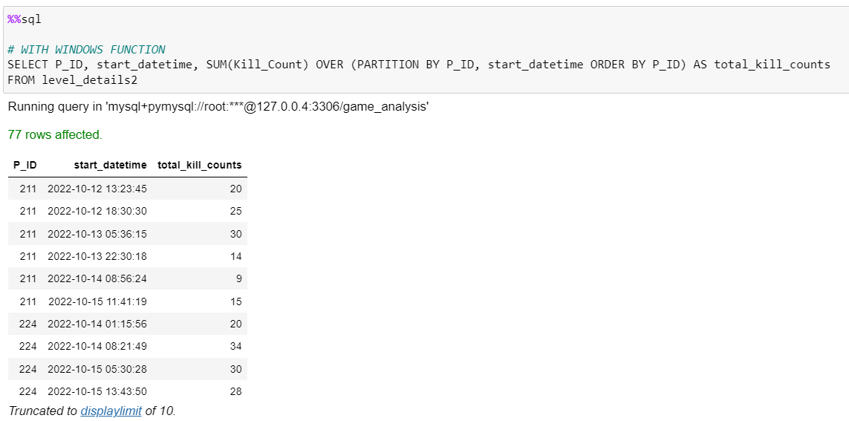
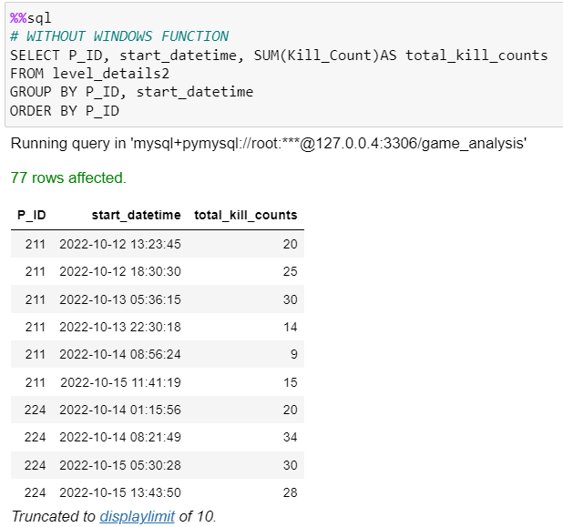
QUESTION 11
. For each player and date, determine how many `kill_counts` were played by the player so far. a) Using window functions b) Without window function

Slide 20
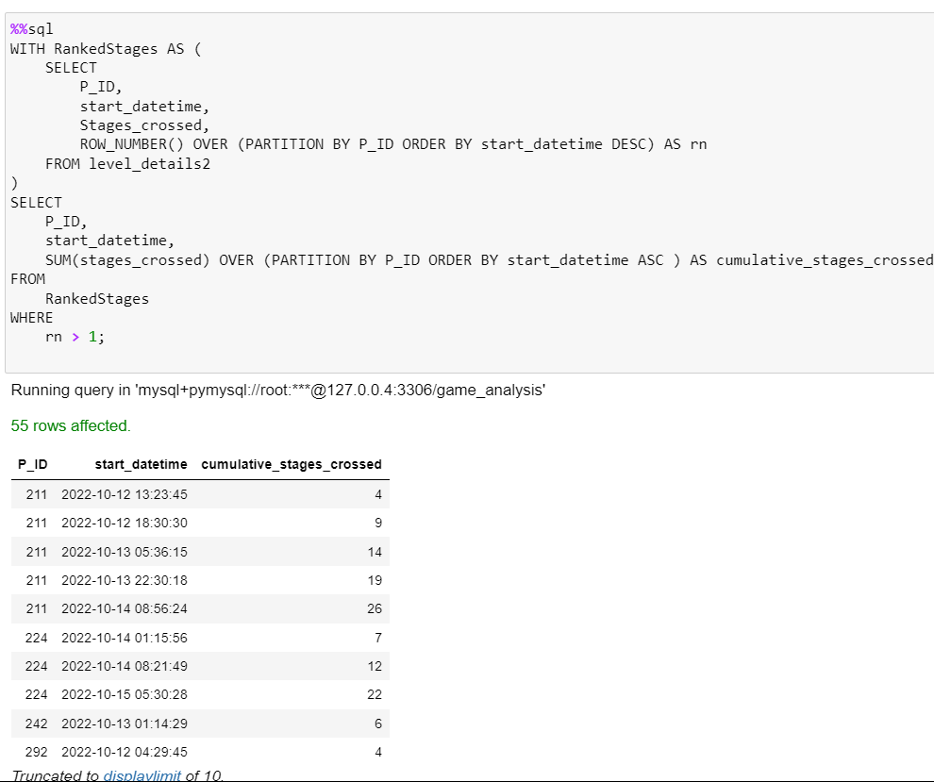
QUESTION 12
Find the cumulative sum of stages crossed over `start_datetime` for each `P_ID`, excluding the most recent `start_datetime`.

Slide 21
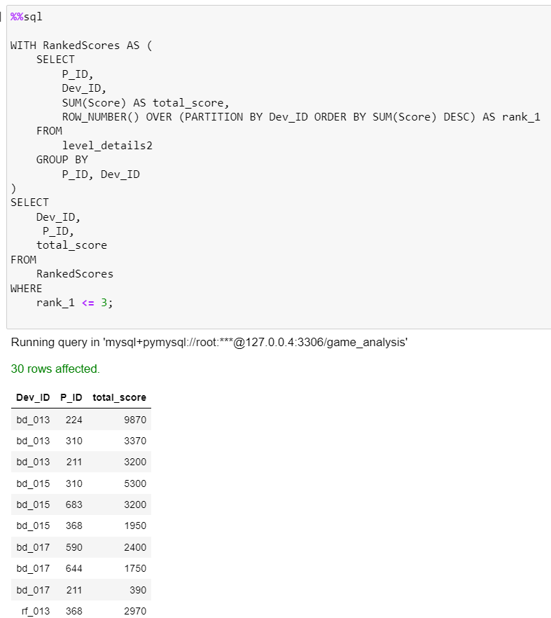
QUESTION 13
Extract the top 3 highest sums of scores for each `Dev_ID` and the corresponding `P_ID

Slide 22
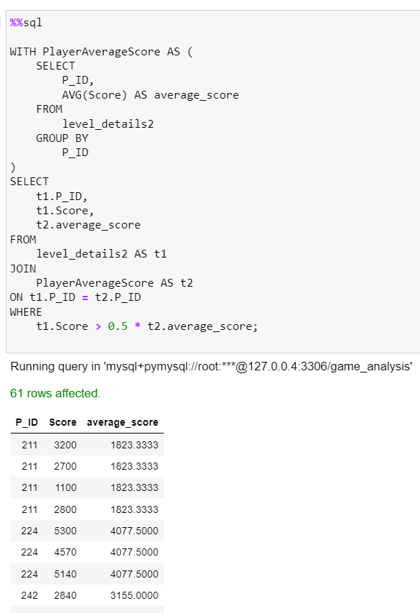
QUESTION 14
Find players who scored more than 50% of the average score, scored by the sum of scores for each `P_ID`.

Slide 23
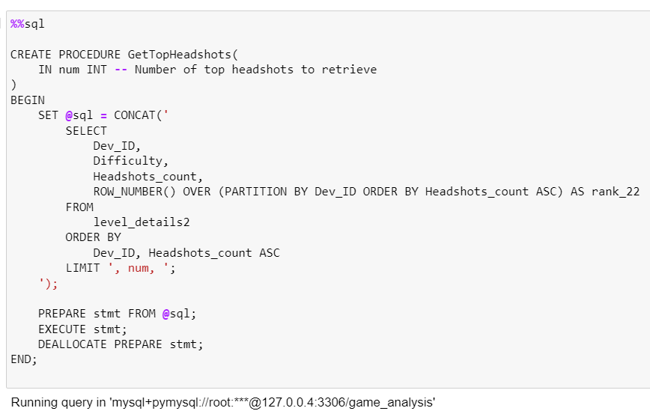
QUESTION 15
Create a stored procedure to find the top `n` `headshots_count` based on each `Dev_ID` and rank them in increasing order using `Row_Number`. Display the difficulty as well

Slide 24
conclusion
From the queries we now have insight into users gaming behaviours and this information can help game developers in the production and upgrade of games

Slide 25


